Slide 1
ORACLE SQL(Session 1)

Slide 2
Objective
Introduction to Databases
DBMS
RDBMS
Oracle
SQL
Data type
Types of SQL(DRL,DDL, DML, DCL, TL)
Writing Select Statement.

Slide 3
Introduction to Database
Database:
A database is a collection of Data (Information)
SQL is used to access
Examples: Attendance Register, Telephone Directory
DatabaseManagement System(DBMS):
Set of programs to access the data
acts as a interface between user and database.
Relational DatabaseManagement System(RDBMS):
A Database Management System based on Relational Data Model

Slide 4
Cont…
Oracle:
An Object-Relational Database Management System
Leading RDBMS vendor worldwide.
Half of RDBMS worldwide market is owned by Oracle.
Oracle Database:
Contains Logical and Physical Structures
Logical Structures are tablespaces, Schema objects, extents and segments
Physical Structure are Control Files , Datafiles, Redo Log Files

Slide 5
Physical Structure
Datafile:-contain all the database data
Controlfile:- contains entries that specify the physical structure of the database such as Database name and the Names and locations of datafiles and redo log files.
Redo Log Files:- to record all changes made to data

Slide 6
Logical Structure
Tablespace:- A database is divided into logical storage units.
Schema Object: the logical structures that directly refer to the database's data. Schema objects include structures like tables, views, and indexes.
Extents:- An extent is a specific number of contiguous data blocks, obtained in a single allocation, used to store a specific type of information.
Segments: -a set of extents allocated for a certain logical structure

Slide 7
What is SQL?
SQL is a language that all commercial RDBMS implementations understand.
SQL is a non-procedural language
SQL is used to communicate with server

Slide 8
Data Types
Char:-fixed length char string---char(len)
Varchar2:-variable length char string---varchar2(len)
Number:-decimal or float no---number(p,s)
Date:-dates---date
Long:-variable length character upto 2GB
CLOB:-character data upto 4GB
Raw:-Binary data upto 2GB---Raw(size)
Long Raw:-Binary data upto 4GB—Long Raw
BFile:Binary data stored in a File

Slide 9
Operators
Arithmetic operators like +,-,*,/
Logical operators: AND, OR,NOT
Relational operators: =,<,>,<=,>=, !=,< >

Slide 10
Statements
Data Retrieval Language(Select)
Data Definition Language(Create,Alter,Drop,Rename,Truncate)
Data Manipulation Language(Insert,Update,Delete)
Data Control language(Grant,Revoke)
Data Transaction Language(Commit,Rollback,Savepoint)

Slide 11
Data Retrieval Language(DRL)
Retrieve data from one or more tables or views
Syntax:
Select *|{[distinct] column|expression [aias] from table;
Select identify what column
From identify which table
Examle:
Select * from emp;

Slide 12
Basic SELECT Statement
SELECT *|{[DISTINCT] column|expression [alias],...}
FROM table;
SELECT identifies what columns
FROM identifies which table

Slide 13

Selecting All Columns
SELECT *
FROM departments;

Slide 14

Selecting Specific Columns
SELECT department_id, location_id
FROM departments;

Slide 15
Writing SQL Statements
SQL statements are not case sensitive.
SQL statements can be on one or more lines.
Keywords cannot be abbreviated or split
across lines.
Clauses are usually placed on separate lines.

Slide 16
Arithmetic Expressions
Create expressions with number and date data by using arithmetic operators.
Operator
+
-
*
/
Description
Add
Subtract
Multiply
Divide

Slide 17


Using Arithmetic Operators
SELECT last_name, salary, salary + 300
FROM employees;
…

Slide 18
Operator Precedence
_
*
/
+
Multiplication and division take priority over addition and subtraction.
Operators of the same priority are evaluated from left to right.
Parentheses are used to force prioritized evaluation and to clarify statements.

Slide 19
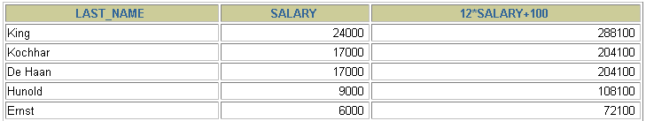

Operator Precedence
SELECT last_name, salary, 12*salary+100
FROM employees;
…

Slide 20
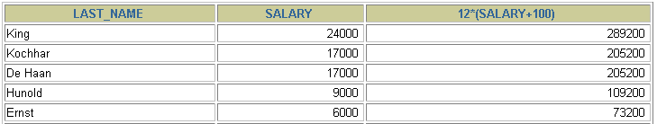

Using Parentheses
SELECT last_name, salary, 12*(salary+100)
FROM employees;
…

Slide 21
Defining a Null Value
A null is a value that is unavailable, unassigned, unknown, or inapplicable.
A null is not the same as zero or a blank space.
SELECT last_name, job_id, salary, commission_pct
FROM employees;
…
…

Slide 22
Null Values in Arithmetic Expressions
Arithmetic expressions containing a null value evaluate to null.
SELECT last_name, 12*salary*commission_pct
FROM employees;
…
…

Slide 23
Defining a Column Alias
A column alias:
Renames a column heading
Is useful with calculations
Immediately follows the column name - there can also be the optional AS keyword between the column name and alias
Requires double quotation marks if it contains spaces or special characters or is case sensitive

Slide 24


Using Column Aliases
SELECT last_name AS name, commission_pct comm
FROM employees;
…
SELECT last_name "Name", salary*12 "Annual Salary"
FROM employees;
…

Slide 25
Concatenation Operator
A concatenation operator:
Concatenates columns or character strings to other columns
Is represented by two vertical bars (||)
Creates a resultant column that is a character expression

Slide 26
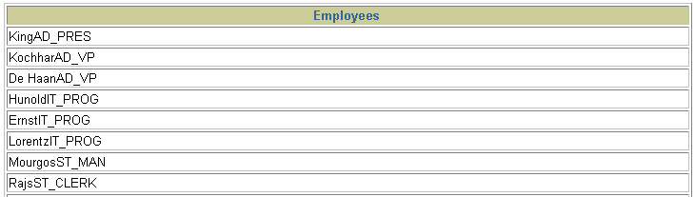
Using the Concatenation Operator
SELECT last_name||job_id AS "Employees"
FROM employees;
…

Slide 27
Literal Character Strings
A literal is a character, a number, or a date included in the SELECT list.
Date and character literal values must be enclosed within single quotation marks.
Each character string is output once for each
row returned.

Slide 28

Using Literal Character Strings
SELECT last_name ||' is a '||job_id
AS "Employee Details"
FROM employees;
…

Slide 29
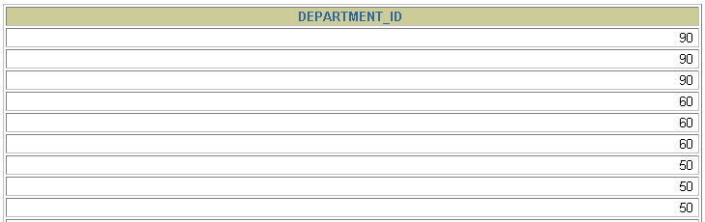
Duplicate Rows
The default display of queries is all rows, including duplicate rows.
SELECT department_id
FROM employees;
…

Slide 30

Eliminating Duplicate Rows
Eliminate duplicate rows by using the DISTINCT keyword in the SELECT clause.
SELECT DISTINCT department_id
FROM employees;

Slide 31


Limiting Rows Using a Selection
EMPLOYEES
…
“retrieve all
employees
in department 90”

Slide 32
Limiting the Rows Selected
Restrict the rows returned by using the WHERE clause.
The WHERE clause follows the FROM clause.
SELECT *|{[DISTINCT] column|expression [alias],...}
FROM table
[WHERE condition(s)];

Slide 33

Using the WHERE Clause
SELECT employee_id, last_name, job_id, department_id
FROM employees
WHERE department_id = 90 ;

Slide 34
Character Strings and Dates
Character strings and date values are enclosed in single quotation marks.
Character values are case sensitive, and date values are format sensitive.
The default date format is DD-MON-RR.
SELECT last_name, job_id, department_id
FROM employees
WHERE last_name = 'Whalen';

Slide 35
Comparison Conditions
Operator
=
>
>=
<
<=
<>
Meaning
Equal to
Greater than
Greater than or equal to
Less than
Less than or equal to
Not equal to

Slide 36

Using Comparison Conditions
SELECT last_name, salary
FROM employees
WHERE salary <= 3000;

Slide 37
Other Comparison Conditions
Operator
BETWEEN
...AND...
IN(set)
LIKE
IS NULL
Meaning
Between two values (inclusive),
Match any of a list of values
Match a character pattern
Is a null value

Slide 38

Using the BETWEEN Condition
Use the BETWEEN condition to display rows based on a range of values.
SELECT last_name, salary
FROM employees
WHERE salary BETWEEN 2500 AND 3500;
Lower limit
Upper limit

Slide 39

Using the IN Condition
Use the IN membership condition to test for values in a list.
SELECT employee_id, last_name, salary, manager_id
FROM employees
WHERE manager_id IN (100, 101, 201);

Slide 40
Using the LIKE Condition
Use the LIKE condition to perform wildcard searches of valid search string values.
Search conditions can contain either literal characters or numbers:
  % denotes zero or many characters.
  _ denotes one character.
SELECT first_name
FROM employees
WHERE first_name LIKE 'S%';

Slide 41

Using the LIKE Condition
You can combine pattern-matching characters.
You can use the ESCAPE identifier to search for the actual % and _ symbols.
SELECT last_name
FROM employees
WHERE last_name LIKE '_o%';

Slide 42
Using the NULL Conditions
Test for nulls with the IS NULL operator.
SELECT last_name, manager_id
FROM employees
WHERE manager_id IS NULL;

Slide 43
Logical Conditions
Operator
AND
OR
NOT
Meaning
Returns TRUE if both component conditions are true
Returns TRUE if either component condition is true
Returns TRUE if the following condition is false

Slide 44

Using the AND Operator
AND requires both conditions to be true.
SELECT employee_id, last_name, job_id, salary
FROM employees
WHERE salary >=10000
AND job_id LIKE '%MAN%';

Slide 45

Using the OR Operator
OR requires either condition to be true
SELECT employee_id, last_name, job_id, salary
FROM employees
WHERE salary >= 10000
OR job_id LIKE '%MAN%';

Slide 46

Using the NOT Operator
SELECT last_name, job_id
FROM employees
WHERE job_id
NOT IN ('IT_PROG', 'ST_CLERK', 'SA_REP');

Slide 47
Rules of Precedence
Order Evaluated Operator
1 Arithmetic operators
2 Concatenation operator
3 Comparison conditions
4 IS [NOT] NULL, LIKE, [NOT] IN
5 [NOT] BETWEEN
6 NOT logical condition
7 AND logical condition
8 OR logical condition
Override rules of precedence by using parentheses.

Slide 48

Rules of Precedence
SELECT last_name, job_id, salary
FROM employees
WHERE job_id = 'SA_REP'
OR job_id = 'AD_PRES'
AND salary > 15000;

Slide 49
Rules of Precedence
Use parenthesis to force priority
SELECT last_name, job_id, salary
FROM employees
WHERE (job_id = 'SA_REP'
OR job_id = 'AD_PRES')
AND salary > 15000;

Slide 50


